Slide 1
Spike Trains
Kenneth D. Harris
3/2/2015

Slide 2
You have recorded one neuron
How do you analyse the data?
Different types of experiment:
Controlled presentation of sensory stimuli
Uncontrolled active behaviour (e.g. spatial navigation)

Slide 3
Today we will look at
Visualization methods for exploratory analyses (raster plots)
Some math (point process theory)
Some tools for confirmatory analyses
Peristimulus time histogram,
Place field estimation
Measures of spike train prediction quality

Slide 4
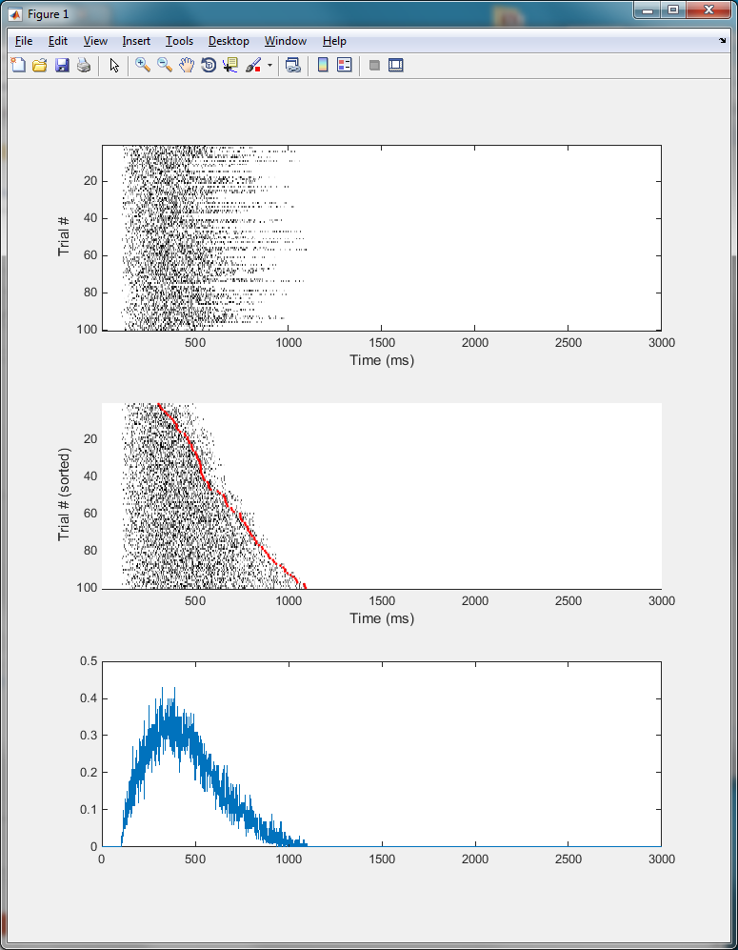
The raster plot
Stimulus onset at 100ms

Slide 5
Sorting a raster plot
Stimulus onset at 100ms
Movement response occurs a random time later

Slide 6
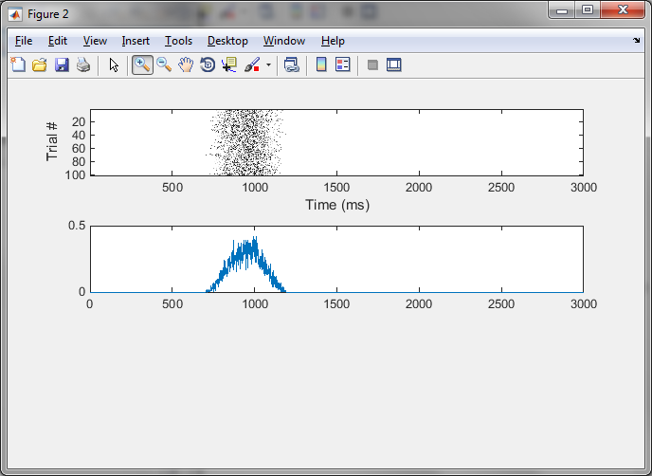
Align to movement onset
Now you don’t see stimulus response

Slide 7
Sorting by mean firing rate
Luczak et al, J Neurosci 2013

Slide 8
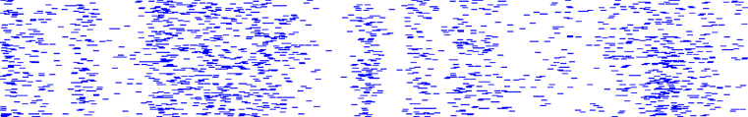
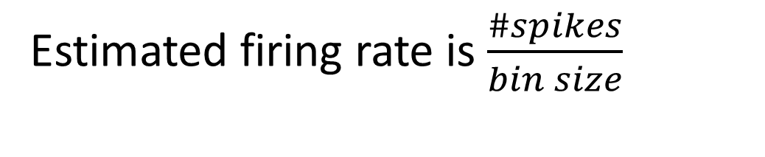
Peri-Stimulus time histogram (PSTH)
Local field potential
Trial #
Spike count in bin
Time
Time
Estimated firing rate is $\frac{\#spikes}{bin size}$

Slide 9
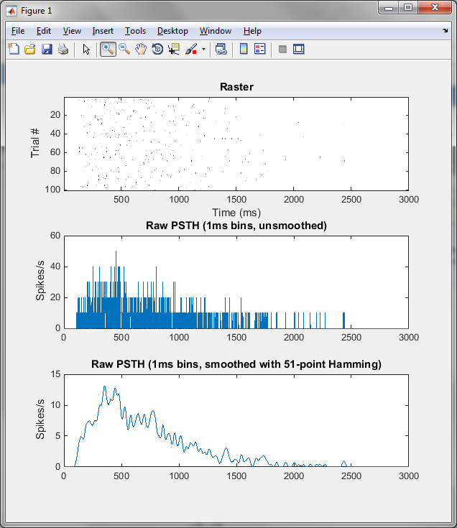
How to compute PSTH from limited data
Convolve PSTH with a kernel
Kernel values must sum to 1!
What kernel to use?
Wider means smoother, but lose time resolution
Causal?

Slide 10
Point processes
A point process defines a probability distribution over the space of possible spike trains
Sample space =
all possible spike trains
Probability density 0.000343534976

Slide 11
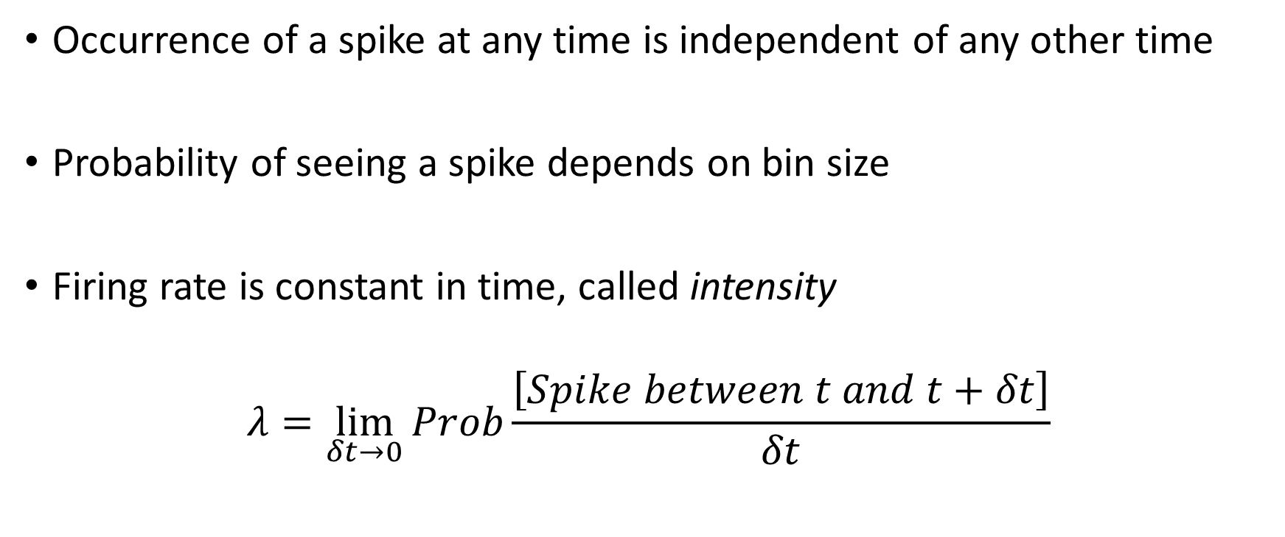
The Poisson process
Occurrence of a spike at any time is independent of any other time
Probability of seeing a spike depends on bin size
Firing rate is constant in time, called intensity
$$λ=\lim_{δt→0}{Prob\frac{\left[Spike between t and t+δt\right]}{δt}}$$

Slide 12
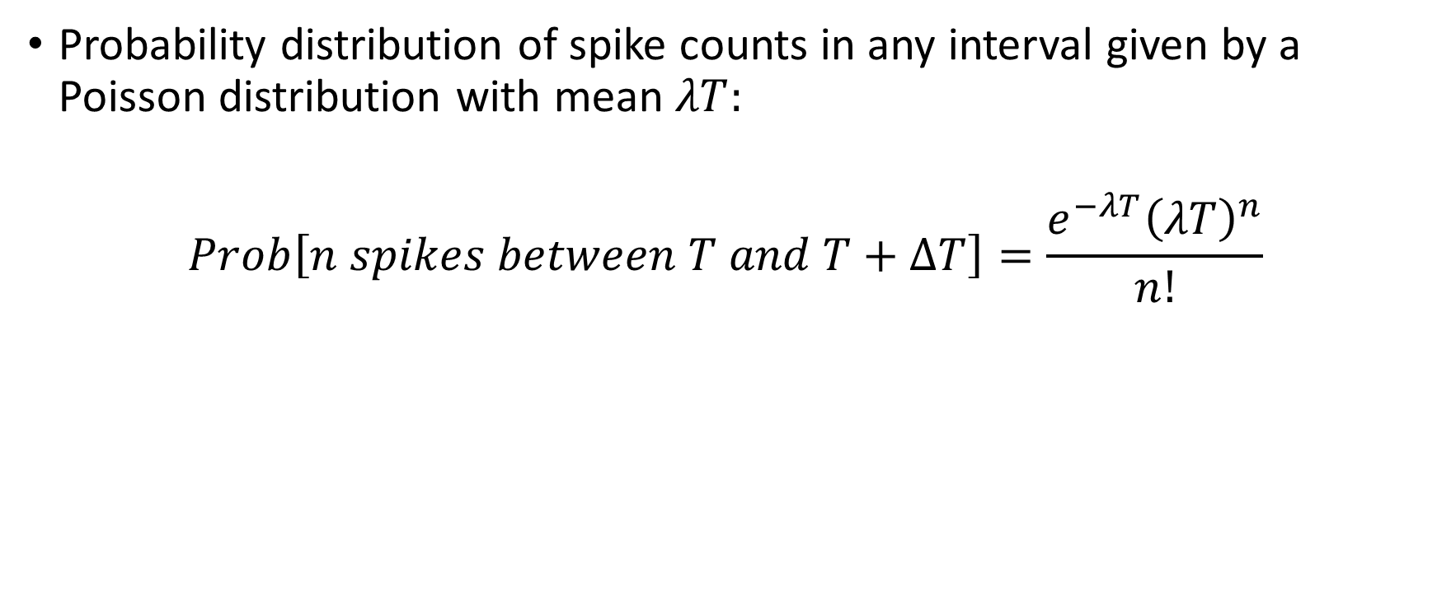
Spike counts in the Poisson process
Probability distribution of spike counts in any interval given by a Poisson distribution with mean $λT:$
$$Prob\left[n spikes between T and T+ΔT\right]=\frac{e^{−λT}{\left(λT\right)}^{n}}{n!}$$

Slide 13

Inhomogeneous Poisson process
Intensity depends on time:
$$λ\left(t\right)=\lim_{δt→0}{Prob\frac{\left[Spike between t and t+δt\right]}{δt}}$$
PSTH is an estimator of $λ\left(t\right)$
Local field potential
Time
Intensity
Time

Slide 14
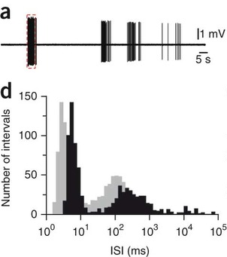
Interspike-interval histogram
Refractory period
Burst peak
Asymptote is zero
Developing cochlear hair cells,
Tritsch et al, Nature Neurosci 2010
Log scale

Slide 15
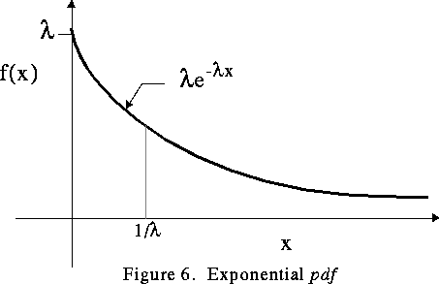
For a Poisson process…

Slide 16
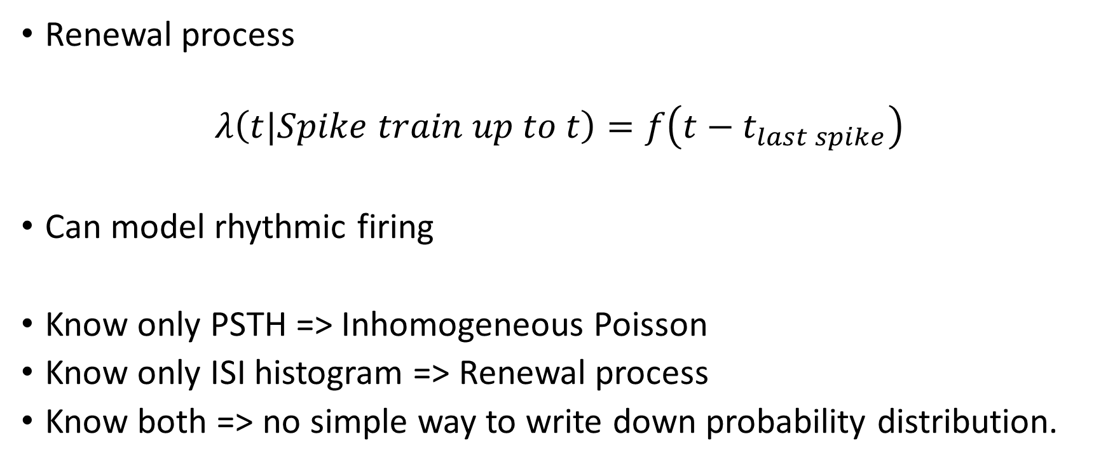
Suppose you only knew ISI histogram
Renewal process
$$λ\left(t|Spike train up to t\right)=f\left(t−t_{last spike}\right)$$
Can model rhythmic firing
Know only PSTH => Inhomogeneous Poisson
Know only ISI histogram => Renewal process
Know both => no simple way to write down probability distribution.

Slide 17
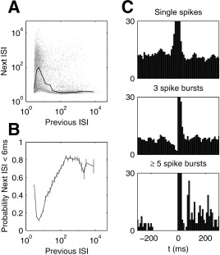
Spike trains are not renewal processes
Hippocampal place cell bursting
Harris et al, Neuron 2001

Slide 18
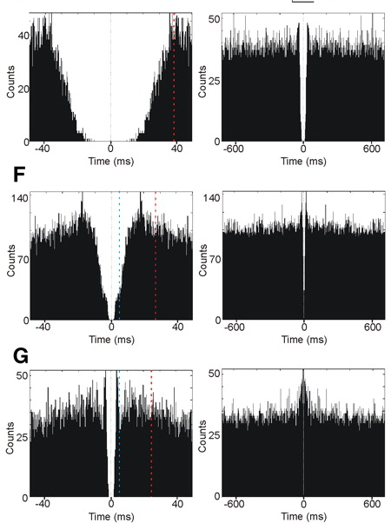
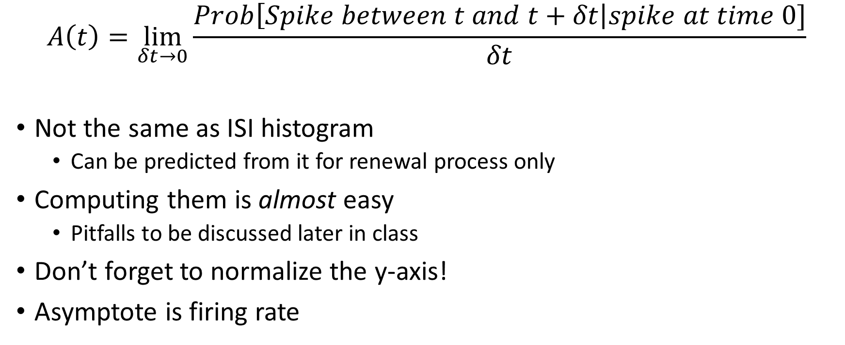
Autocorrelogram
$$A\left(t\right)=\lim_{δt→0}{\frac{Prob\left[Spike between t and t+δt\right|spike at time 0]}{δt}}$$
Not the same as ISI histogram
Can be predicted from it for renewal process only
Computing them is almost easy
Pitfalls to be discussed later in class
Don’t forget to normalize the y-axis!
Asymptote is firing rate
AV Thalamus, Tsanov et al, J Neurophys 2011

Slide 19

Place fields
Firing rate of cell depends on animal’s location
$$λ\left(t\right)=f\left(x\left(t\right)\right)$$
How to estimate $f\left(x\right)$?

Slide 20
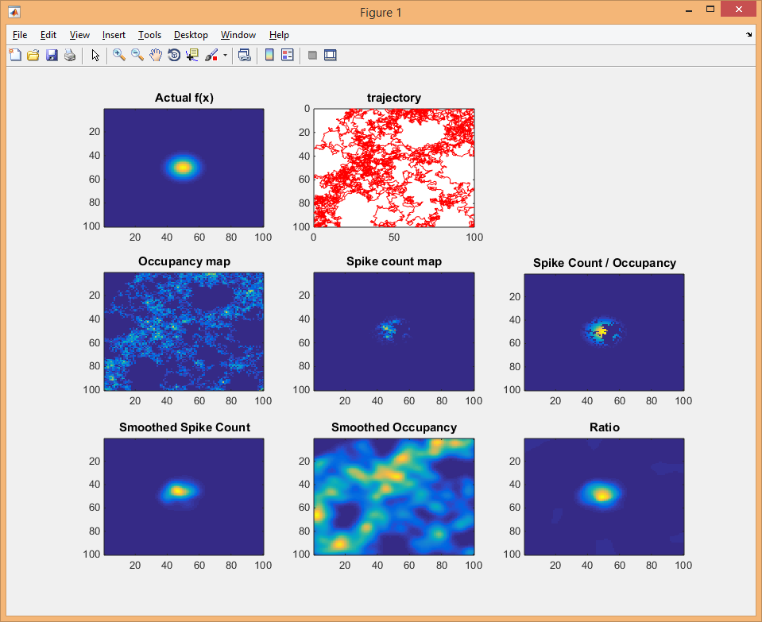
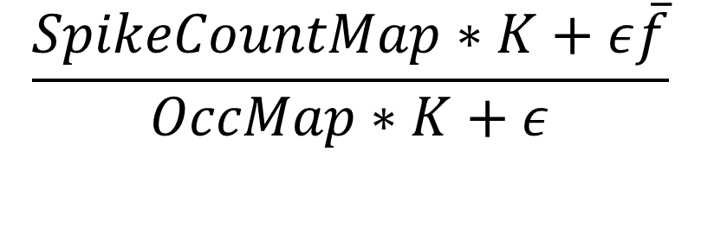
Estimating place fields
$$\frac{SpikeCountMap∗K+ε\overline{f}}{OccMap∗K+ε}$$

Slide 21

This is local maximum likelihood estimation

Slide 22
Confirmatory analysis
Use classical statistics wherever possible
Is there a stimulus response? T-test on spike counts before and after.

Slide 23
Does the response cause an inhibition?
How would you test this? (Discussison)

Slide 24

Comparing spike-train predictions by cross-validation
Was the cell really modulated by position?
Model 1: $λ=constant$
Model 2: $λ=f(x)$
Which one fits the data better?

Slide 25
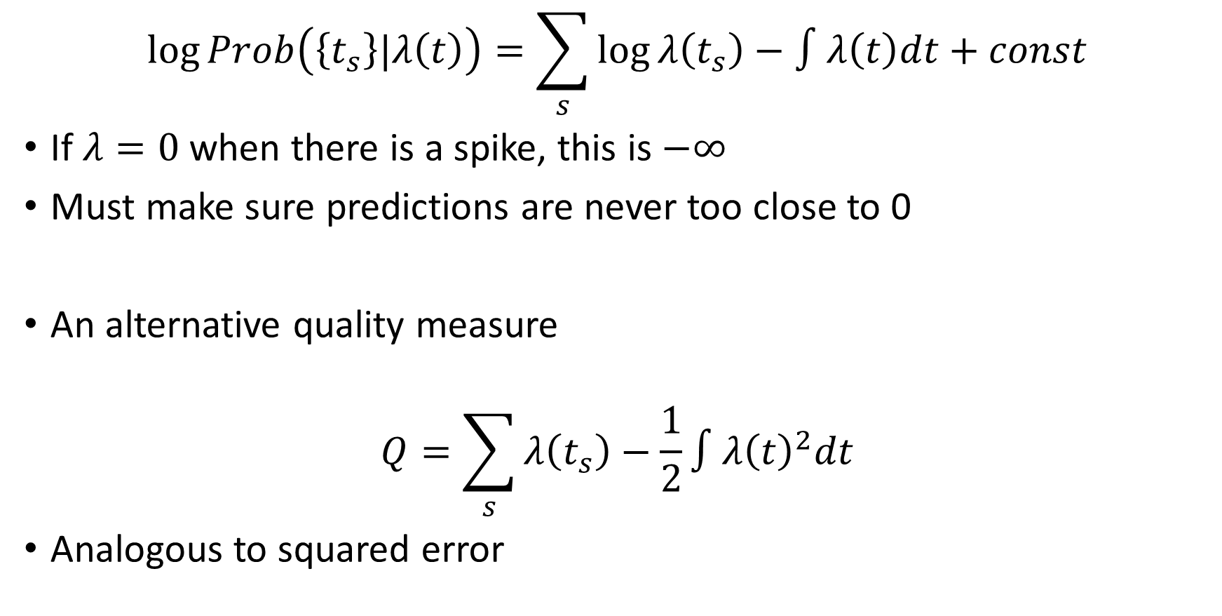
Measuring prediction quality
$$\log{Prob\left(\left\{t_{s}\right\}|λ\left(t\right)\right)}=\sum_{s}{\log{λ\left(t_{s}\right)}}−∫λ\left(t\right)dt+const$$
If $λ=0$ when there is a spike, this is $−∞$
Must make sure predictions are never too close to 0
An alternative quality measure
$$Q=\sum_{s}{λ\left(t_{s}\right)}−\frac{1}{2}∫λ{\left(t\right)}^{2}dt$$
Analogous to squared error
Itskov et al, Neural computation 2008

